Slide 1
American Car License Plate Recognition
EECE7398 Advances in Deep Learning – Final Presentation
Zehua Liu
Xu Liang
Hao Lei

Slide 2
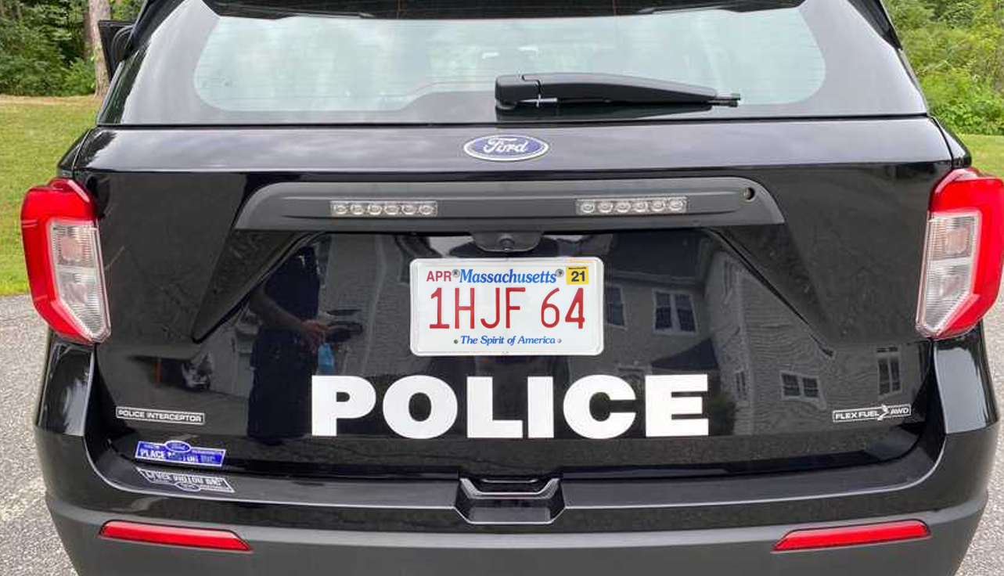
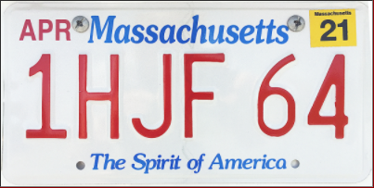


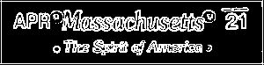
Overview
Due to lack of dataset, split the whole process into small problems and use simple-structure nets to conquer each
Rectangle
detection
candidates
Size/Shape Filter
PVN
Plate Validation Net
Extract top and bottom parts
- Grayscale
- Edge detection - Binarization
1 H J F 6 4
CRN
Char Recognition Net
Character segmentation
Serial extraction
RGB/HSV Info
MA
SRN
State Recognition Net

Slide 3
Road Map
Dataset Manufacturing
Rectangle Detection & Plate Validation
State Recognition & Serial Extraction
Character Segmentation & Recognition
Future Work

Slide 4
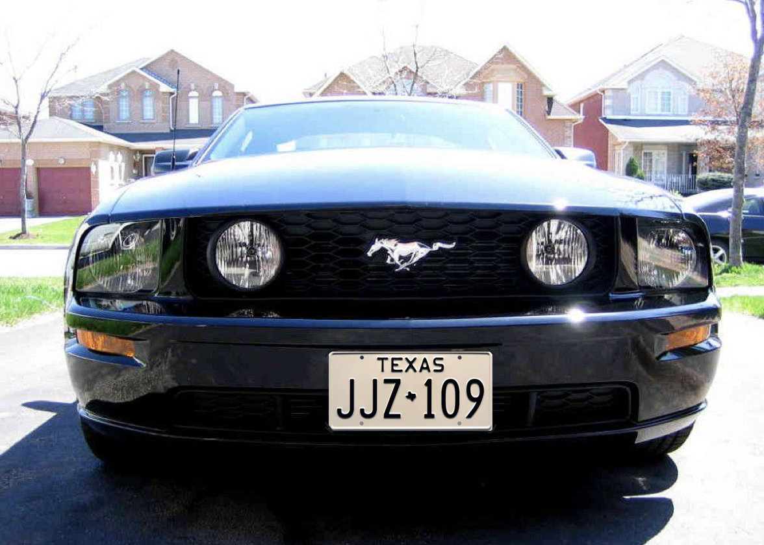
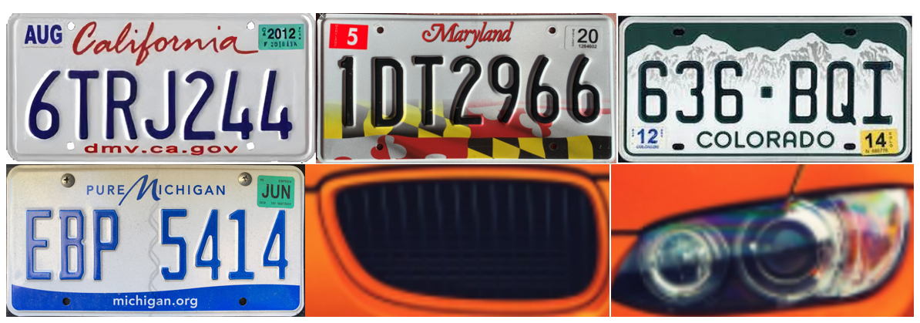
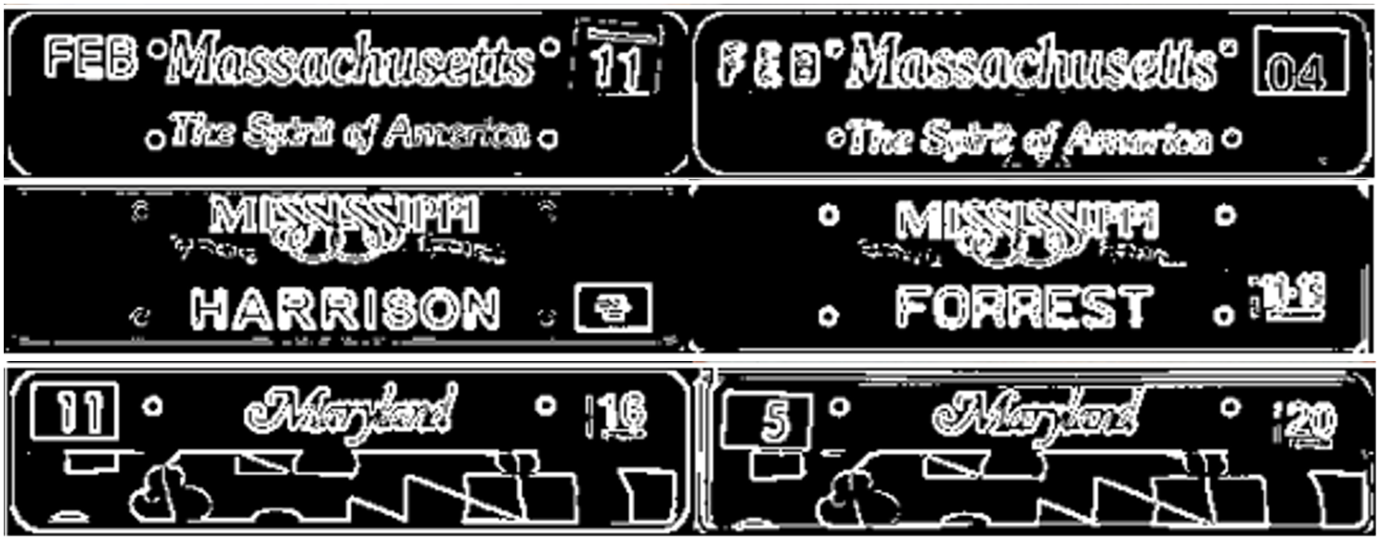
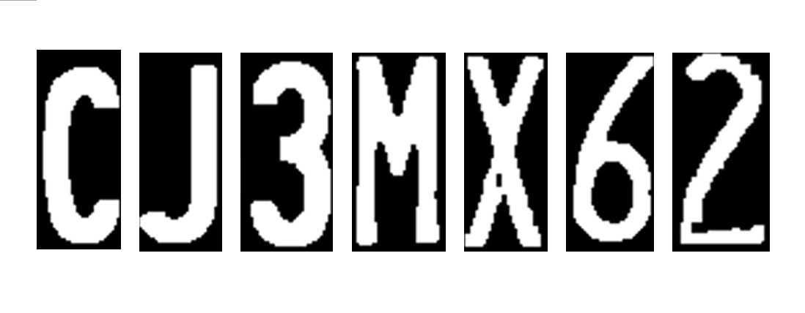
Dataset Manufacturing
Only used for overall test
Derive
PVN
Plate Validation Net
SRN
State Recognition Net
CRN
Char Recognition Net

Slide 5
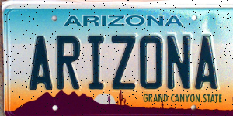
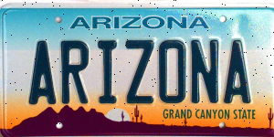

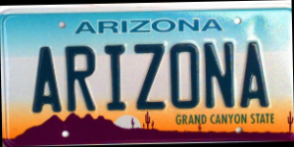
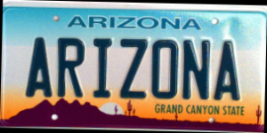
Dataset Manufacturing
No perfect clarity?
No perfect angle?
Add random noise
Add rotations

Slide 6
Road Map
Dataset Manufacturing
Rectangle Detection & Plate Validation
State Recognition & Serial Extraction
Character Segmentation & Recognition
Future Work

Slide 7
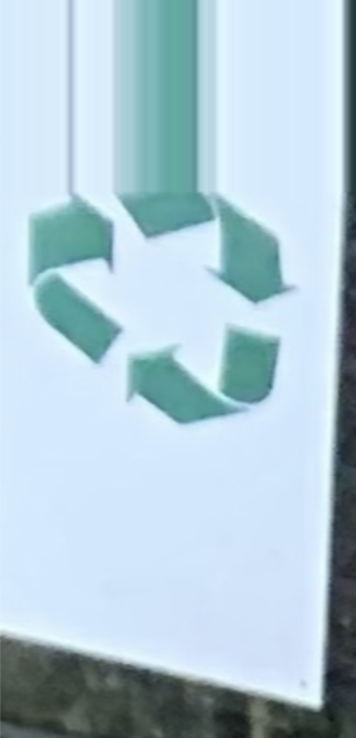
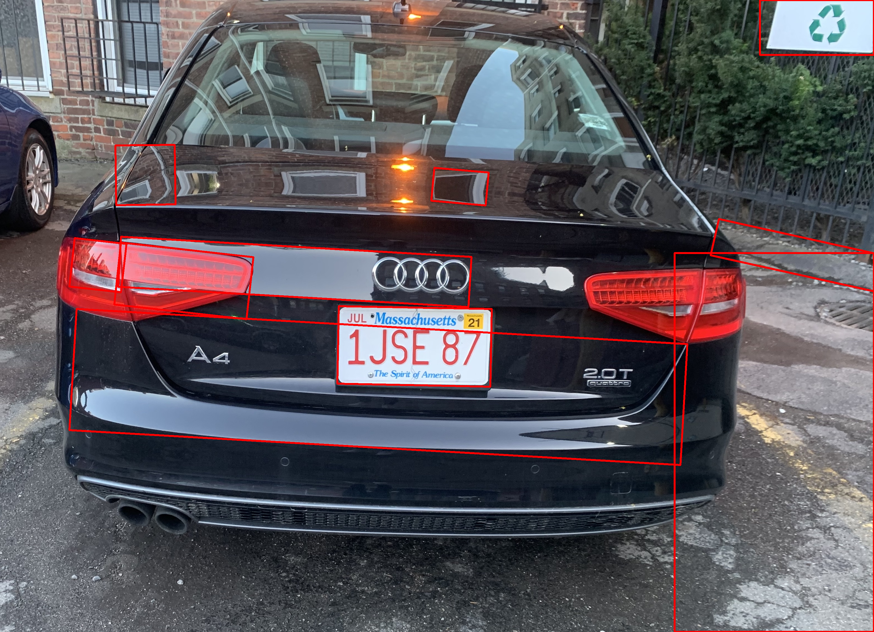
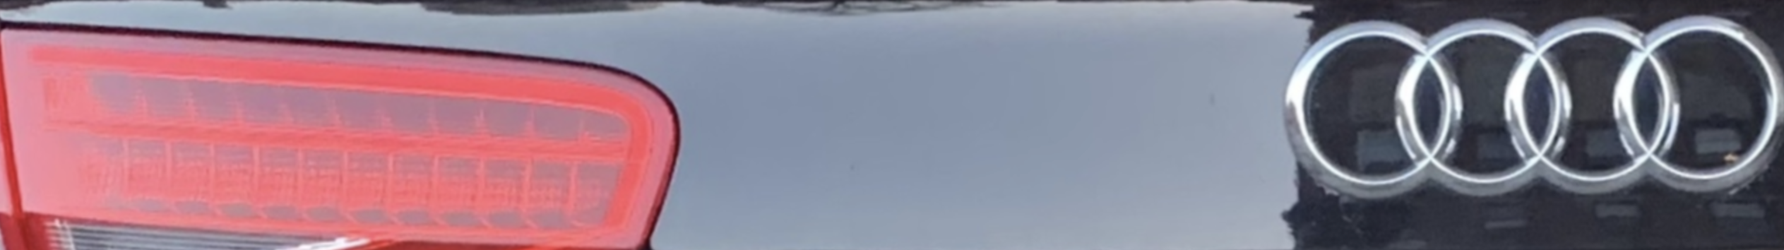
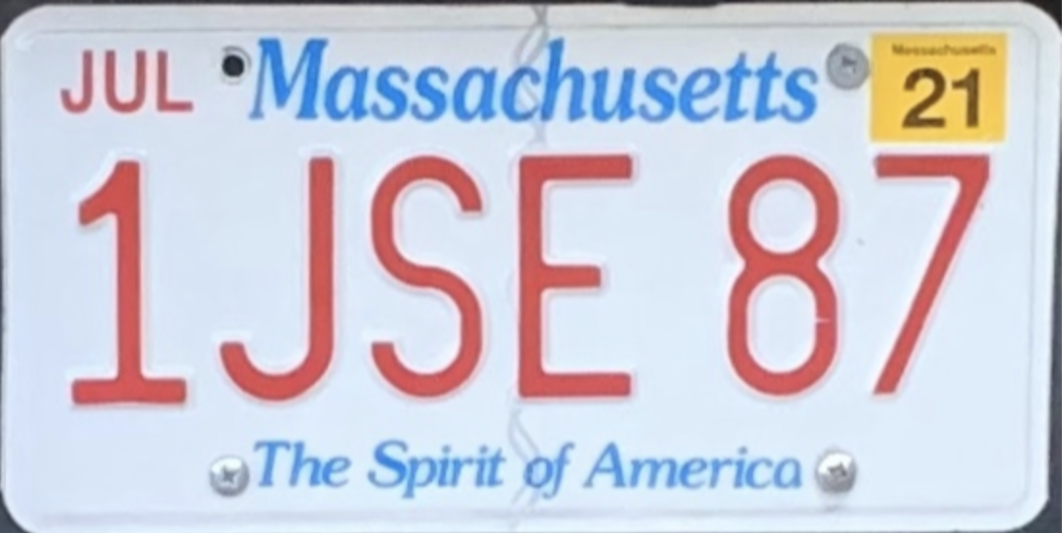
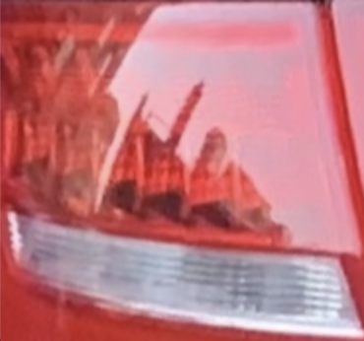
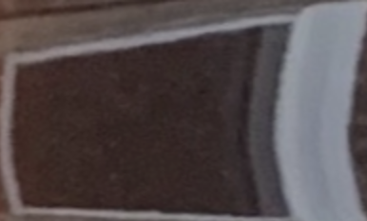
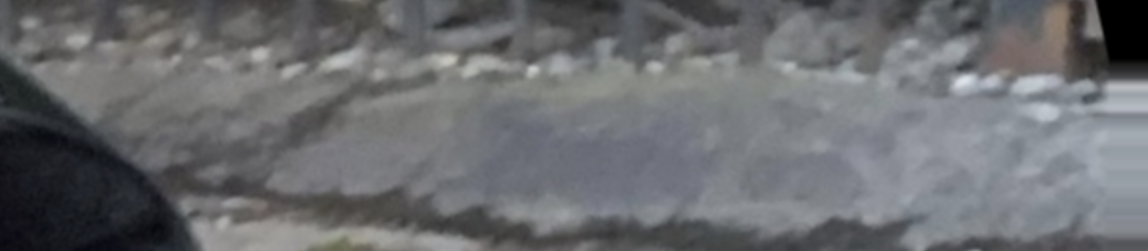
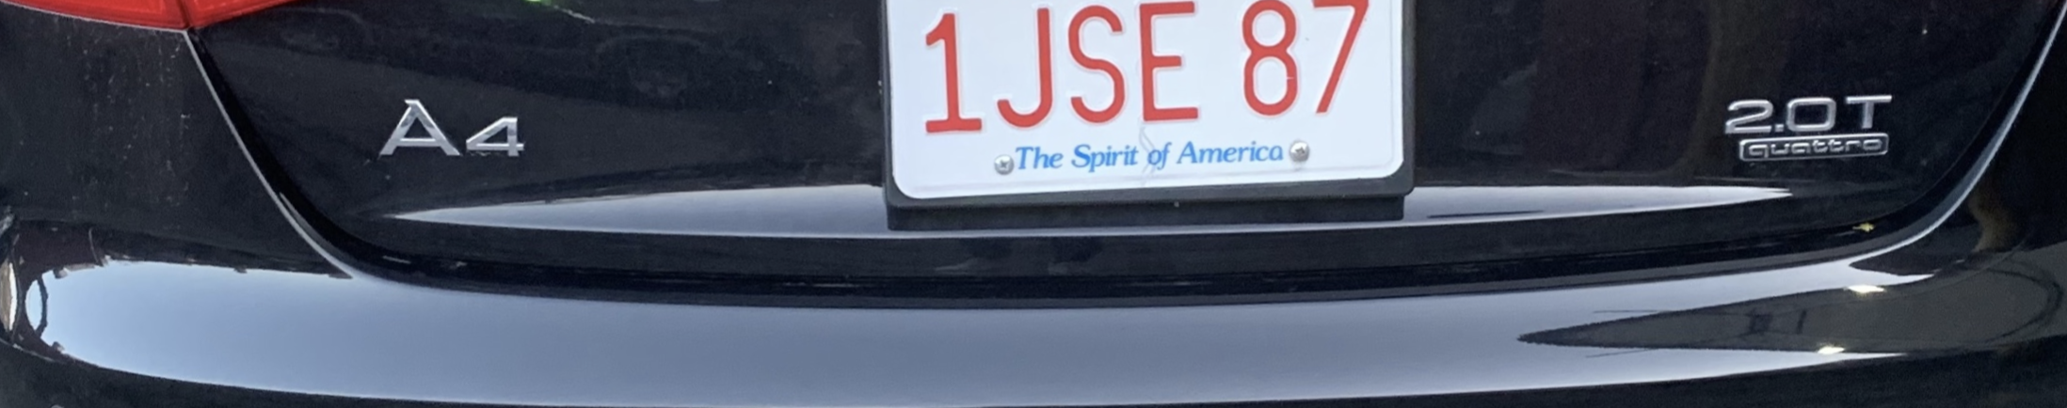
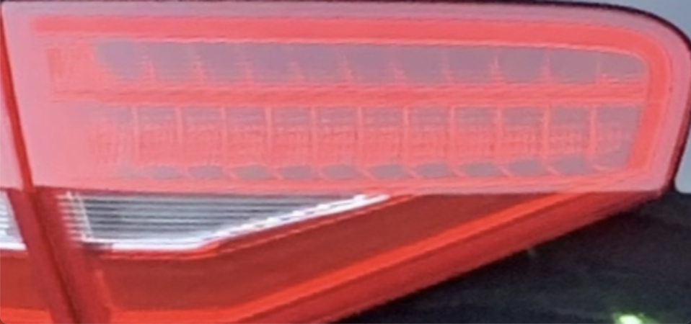
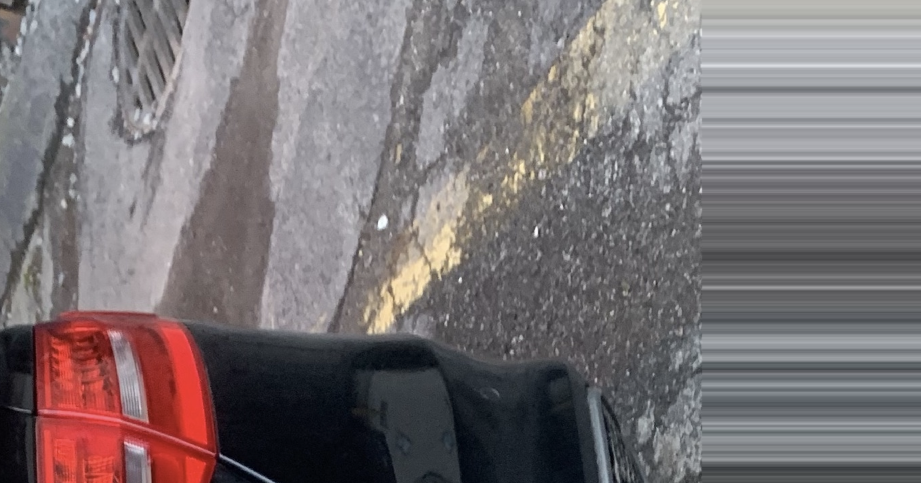
Rectangle Detection and Plate Validation
Find minimum enclosing rectangles with the rational size
Straighten and crop the rectangle images

Slide 8
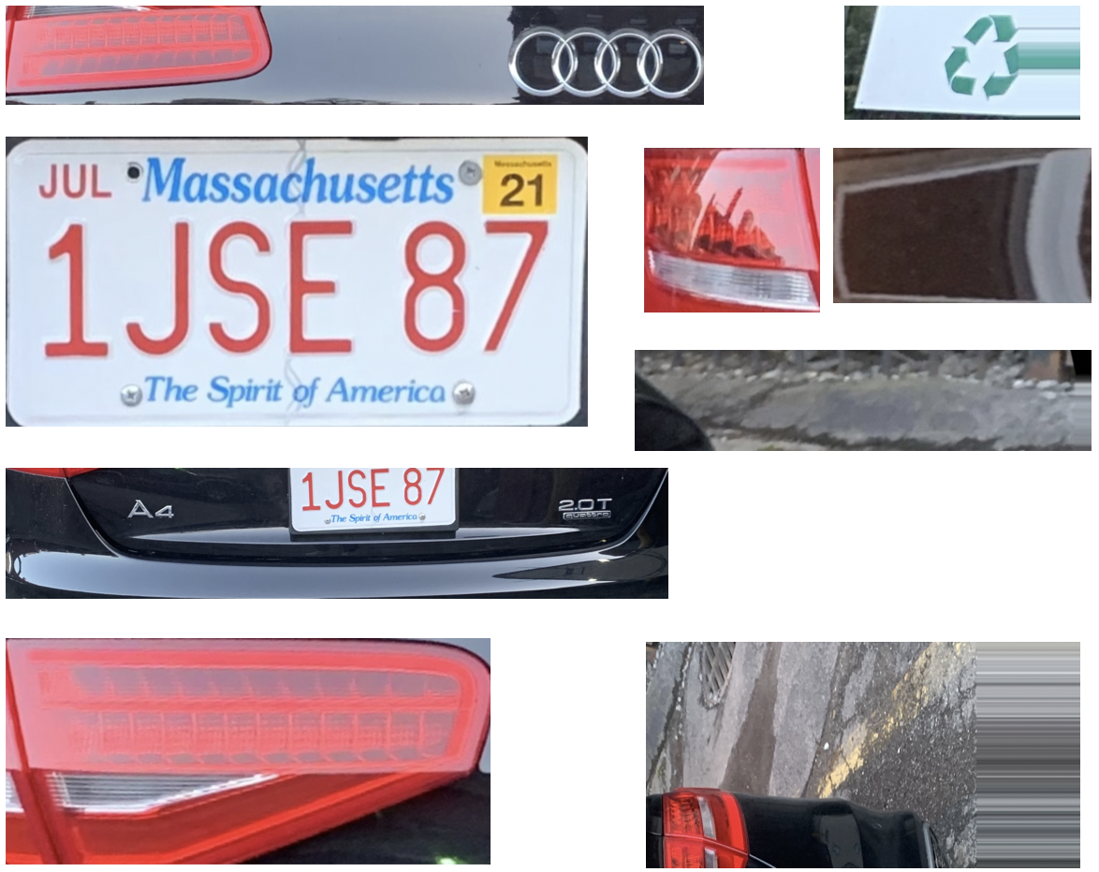
Rectangle Detection and Plate Validation
Cropped rectangle images
The Image verified as True by PVN
PVN
Plate Validation Net

Slide 9
Road Map
Dataset Manufacturing
Rectangle Detection & Plate Validation
State Recognition & Serial Extraction
Character Segmentation & Recognition
Future Work

Slide 10
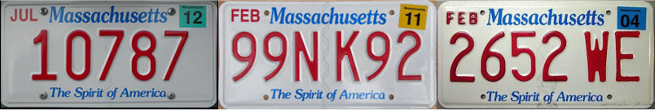
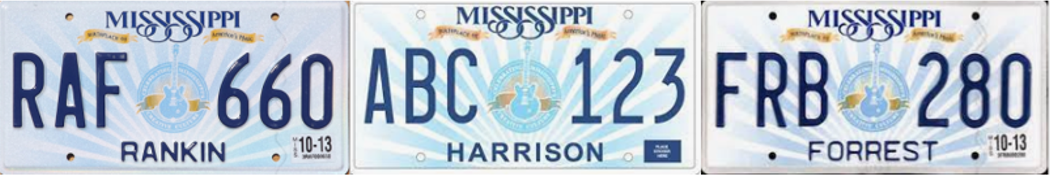
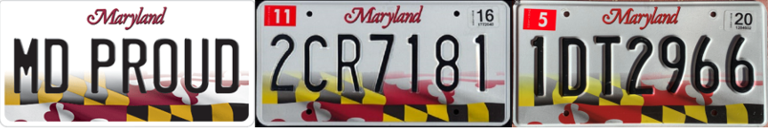
State Recognition and Serial Extraction
Three important properties
Format & Pattern are stable
Serial colors are consistent
Serial colors are different from the background

Slide 11
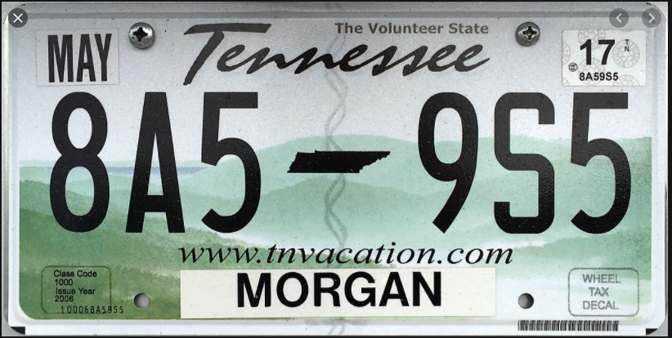
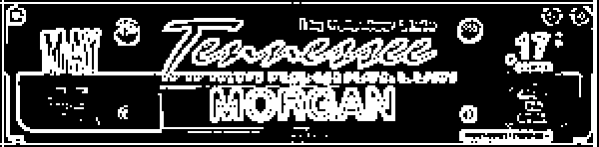
State Recognition and Serial Extraction
State features area
Edge detection & binarization
> 127 ➔ 255
<= 127 ➔ 0
SRN
State Recognition Net
Result: TN
Feature image

Slide 12

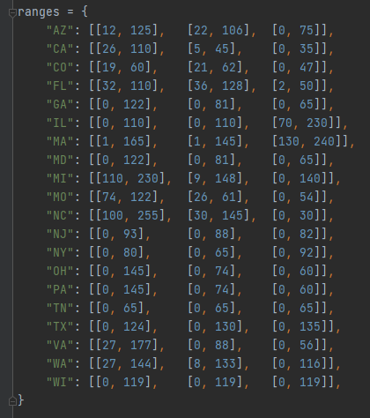
State Recognition and Serial Extraction
Serial area
TN: [[0, 65], [0, 65], [0, 65]]
Look up to
Result: TN
State-color range table

Slide 13
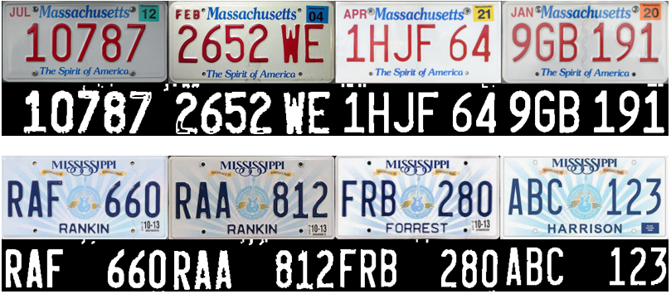
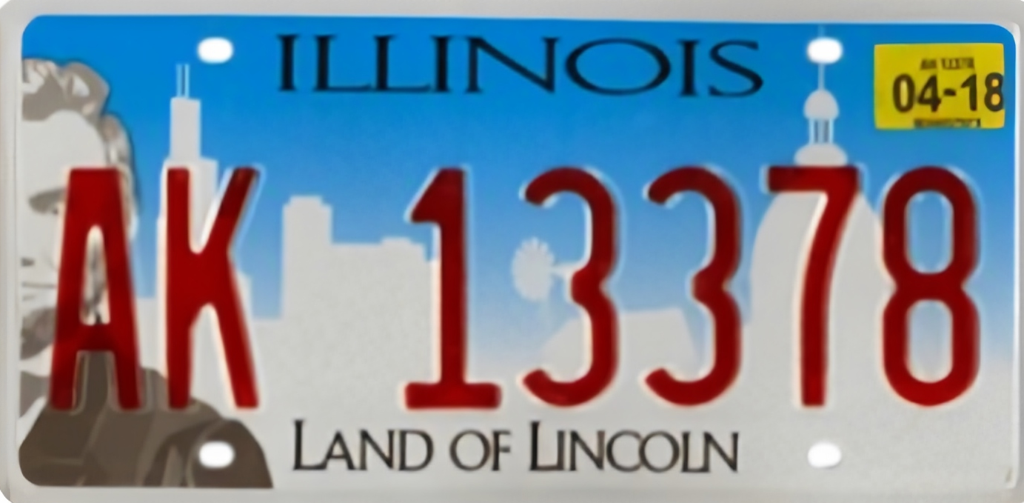

State Recognition and Serial Extraction
New and old license plates?
Different illumination?
Properly widened RGB range
Too-wide RGB range

Slide 14
Road Map
Dataset Manufacturing
Rectangle Detection & Plate Validation
State Recognition and Serial Extraction
Character Segmentation & Recognition
Future Work

Slide 15

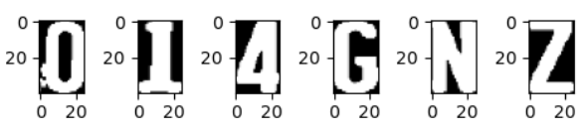
Character Segmentation and Recognition
Find the bounding rectangle
Crop the rectangle image
Normalize the size
CRN
Char Recognition Net
O or 0 ?
Result: 014GNZ

Slide 16
Road Map
Dataset Manufacturing
Rectangle Detection & Plate Validation
State Recognition & Serial Extraction
Character Segmentation & Recognition
Future Work

Slide 17
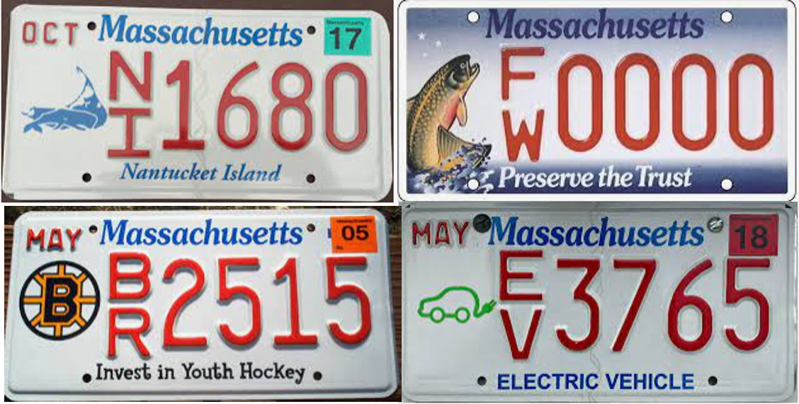
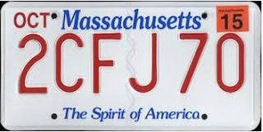
Future Work
1. Improvement of universality
- More states (currently we only deal with the top-20 states with the most population)
- More patterns (people may have various customized plates and different versions)

Slide 18
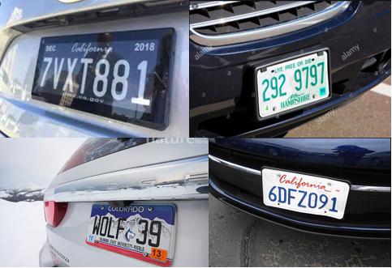
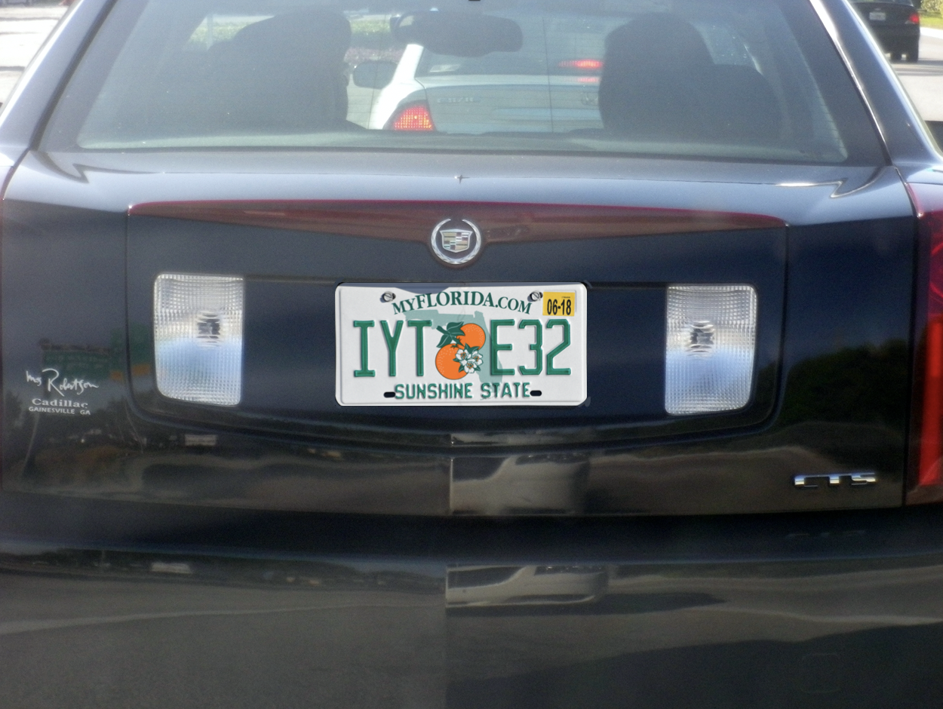
Future Work
2. Various conditions
Currently the condition we assume/restrict is that the recognition happens at the entrance/exit of a parking lot.
- Not perfect angle
- Extreme weather conditions

Slide 19
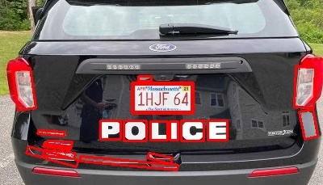
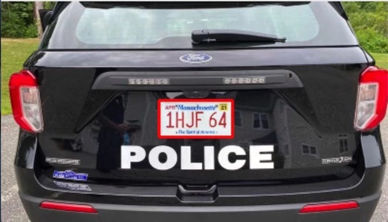
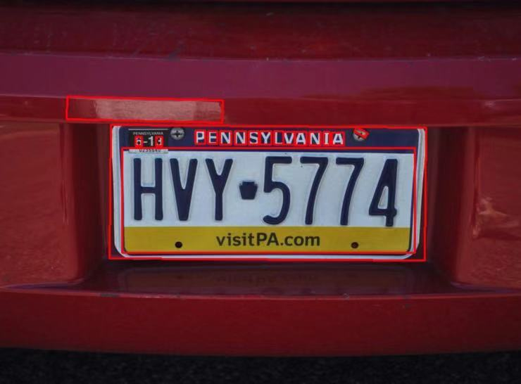
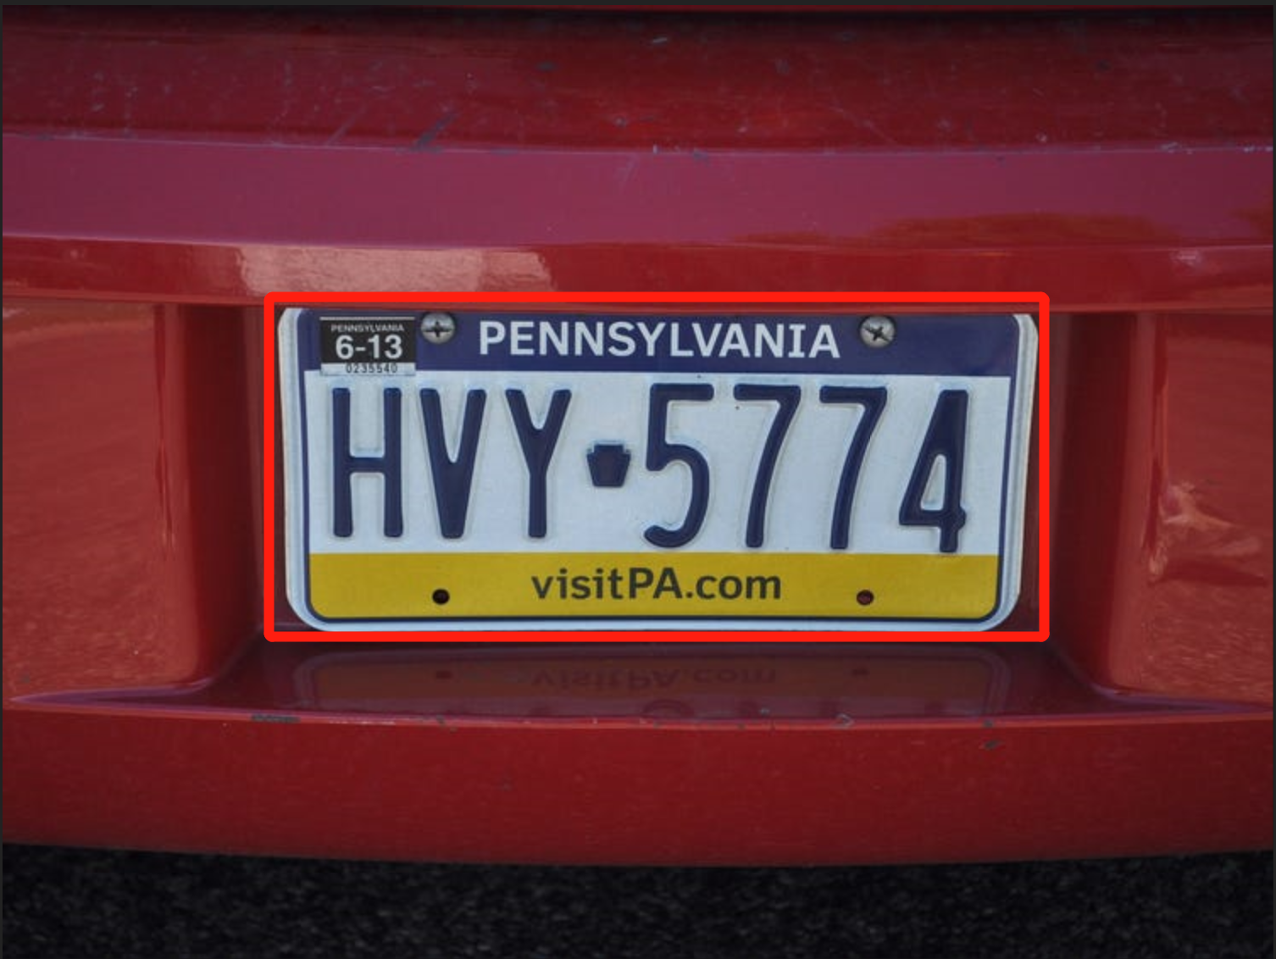
Future Work
3. More robust plate detection
We may consider using YOLO Net in the future to directly detect plate in an image

